Slide 1
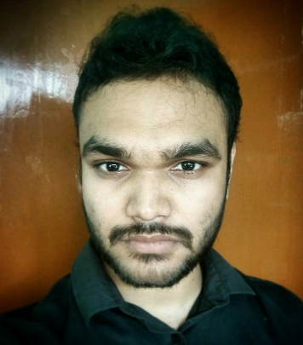



Md. Robin khan
Email: jonakiralo121@gmail.com
Phone: +8801677048891
Present: 17/5B Tollabag, Dhaka Permanent: Sabalia, Tangail.
Career Objectives
To build up my career based on my educational qualification and experience in the field of software engineering. I would like to show my immense aspiration to become a quick learner and to prove myself as a sincere and energetic person through extensive hard working and integrity.
Education
SSC
Institute: Sristy Academic School, Tangail.
Passing year: 2011
GPA: 5.00 out of 5.00
Board: Dhaka
HSC
Institute: Mejor General Mahmudul Hasan Adarsha college, Tangail.
Passing year: 2013
GPA: 4.80 out of 5.00
Board: Dhaka
B.Sc in Software Engineering
Institute: Daffodil International University, Dhaka.
Passing year: Running (final semester)
CGPA: 3.91(current) out of 4.00
Skills
Programming Language : C, C++, C#, JavaScript. Web Technology : ASP.Net (MVC 5, Web API, Core 2.1), Angular4.
Software : Microsoft Office, Microsoft Visual studio, Adobe (Premiere Pro,Photoshop) cs6 .
Language Proficiency : English(Fluent), Bengali(Native). Web : HTML, CSS, ASP.NET MVC.
Database : SQL server 2014, Mysql
Typing speed : 36 wpm.

Slide 2
Projects
Project Name: Organic-shop. This project demonstrates a simple e-commerce application for an imaginary organic shop. It is built with Angular, Firebase and Bootstrap 4 as the final project. GitHub repository: https://github.com/trktuhin/Organic-shop
Project Name: Friends Mess. Friends Mess is a web application which helps one to manage members, meals and expenses of a mess who use mess meal system. It is built with ASP.Net MVC, Razor view engine and Bootstrap. Or you can check the system live at : https://friendsmess.azurewebsites.net GitHub repository: https://github.com/trktuhin/FriendsMess
Project Name: The Address Book This system helps one to manage his address books. There is different types of books including family, office etc. Each address book holds a collection of entries including their name, email, city, contact number and address.. It is built with ASP.Net MVC 5, Razor view engine and Bootstrap. GitHub repository: https://github.com/trktuhin/TheAddressBook
Personal Information
Date of Birth : 14th November, 1994. Marital Status : Unmarried. Gender : Male. Blood Group : Null.
Father’s Name : Md. Hazrat Ali Khan. Mother’s Name : Bina Begum. Nationality : Bangladeshi. Religion : Islam.
References
Asif Khan Shakir Lecturer, dept. of Software Engineering Daffodil International University Dhaka, Bangladesh. Mobile: +8801917607480 Email: asif.swe@diu.edu.bd
I hereby declare that all the information stated above is correct.

